Slide 1
x Tables Visualisation
Beautiful multiplication tables coded in Processing

Slide 2
Description
A poster. It was titled “Times Tables Visualisation”, has every single times table from 0 to 199, making a very beautiful visualisation. It also has a description the idea, and the code.
It started as an animation, and then I turned it into a poster.

Slide 3
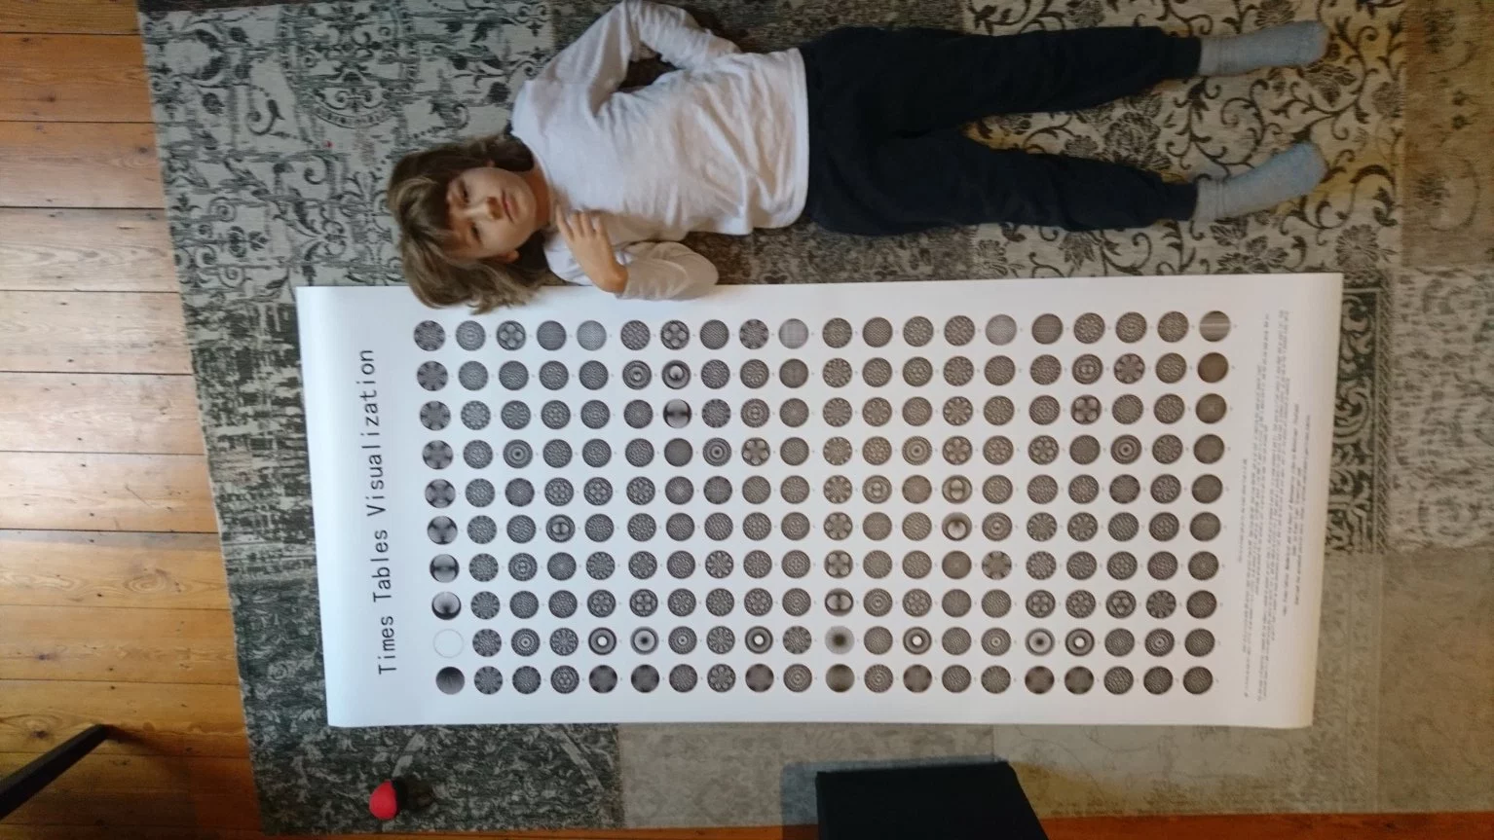

Slide 4
Idea

Slide 7
0
1
11
2
10
3
9
4
8
5
7
6

Slide 8
12 0
1 13
23 11
2 14
22 10
3 15
21 9
4 16
20 8
5 17
19 7
6 18

Slide 9
24 12 0
1 13 25
35 23 11
2 14 26
34 22 10
3 15 27
33 21 9
4 16 28
32 20 8
5 17 29
31 19 7
6 18 30

Slide 10
24 12 0
1 13 25
...
35 23 11
2 14 26
34 22 10
3 15 27
33 21 9
4 16 28
32 20 8
5 17 29
31 19 7
6 18 30

Slide 11
24 12 0
1 13 25
...
35 23 11
2 14 26
34 22 10
3 15 27
33 21 9
4 16 28
32 20 8
5 17 29
31 19 7
6 18 30

Slide 12
24 12 0
1 13 25
...
35 23 11
2 14 26
34 22 10
3 15 27
33 21 9
4 16 28
32 20 8
5 17 29
31 19 7
6 18 30

Slide 13
24 12 0
1 13 25
...
35 23 11
2 14 26
34 22 10
3 15 27
33 21 9
4 16 28
32 20 8
5 17 29
31 19 7
6 18 30

Slide 14
24 12 0
1 13 25
...
35 23 11
2 14 26
34 22 10
3 15 27
33 21 9
4 16 28
32 20 8
5 17 29
31 19 7
6 18 30

Slide 15
24 12 0
1 13 25
...
35 23 11
2 14 26
34 22 10
3 15 27
33 21 9
4 16 28
32 20 8
5 17 29
31 19 7
6 18 30

Slide 16
24 12 0
1 13 25
...
35 23 11
2 14 26
34 22 10
3 15 27
33 21 9
4 16 28
32 20 8
5 17 29
31 19 7
6 18 30

Slide 17
24 12 0
1 13 25
...
35 23 11
2 14 26
34 22 10
3 15 27
33 21 9
4 16 28
32 20 8
5 17 29
31 19 7
6 18 30

Slide 20
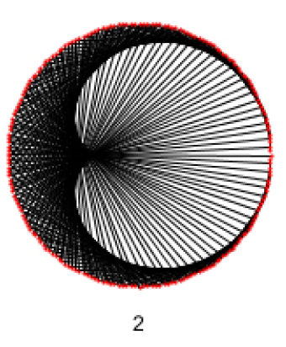

Slide 21
The code!

Slide 22
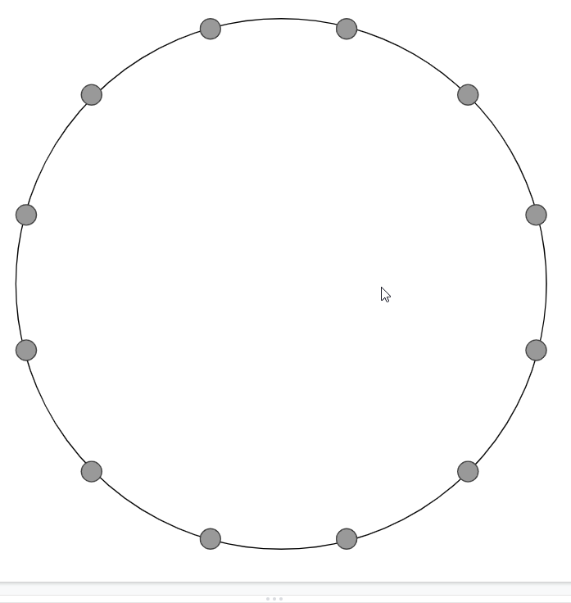

Slide 25
ith
n points
θ = map(i, 0, n, 0, 2π)
θ

Slide 26
3rd
n points
θ = map(3, 0, n, 0, 2π)
θ

Slide 27
ith
n points
θ = map(i, 0, n, 0, 2π)
θ

Slide 28
ith
n points
θ = map(i, 0, n, 0, 2π)
r sin(θ)
r
θ
r cos(θ)

Slide 29
ith
n points
θ = map(i, 0, n, 0, 2π)
x = r cos(θ)
y = r sin(θ)
r sin(θ)
r
θ
r cos(θ)

Slide 30
ith
n points
θ1 = map(i, 0, n, 0, 2π)
x1 = r cos(θ1)
y1 = r sin(θ1)
θ2 = map(j, 0, n, 0, 2π)
x2 = r cos(θ2)
y2 = r sin(θ2)
r sin(θ)
r
θ
r cos(θ)
jth

Slide 31
ith
n points
θ1 = map(i, 0, n, 0, 2π)
x1 = r cos(θ1)
y1 = r sin(θ1)
θ2 = map(j, 0, n, 0, 2π)
x2 = r cos(θ2)
y2 = r sin(θ2)
line(x1, y1, x2, y2)
r sin(θ)
r
θ
r cos(θ)
jth

Slide 32
Do this over and over for all points to their corresponding one.

Slide 33
0

Slide 34
0
I did a small hack for the 0x table. I don’t know why, but for some reason I ended up with an error message instead of a times table! So I’ve done the 200x table instead, it looks the same.

Slide 35
The Poster!

Slide 36
The Poster
I was first about to write the whole poster with code (except for the text). Unfortunately, that is 2000px x 4000px. That’s bigger than an entire screen! Processing can’t manage this. So I made 8 1000px x 1000px pieces instead, and then manually stuck them together. The text was also written manually.

